Slide 1
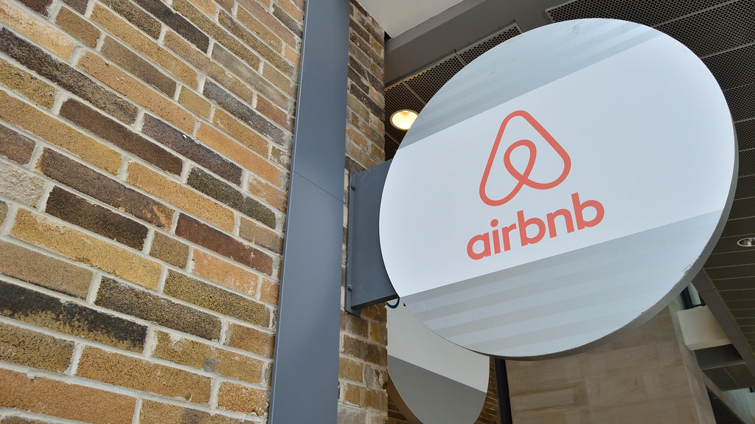
AIRBNB - DATA ANALYTICS AND RECOMMENDER SYSTEM

Slide 2

Travel industries are having important reflection of the economy from past few decades, and Airbnb housing price ranges are of great interest for both Hosts and Traveler. In this project, we are analyzing the various aspects with different use cases which covers many aspects of airbnb listings. It helps in not only understanding the meaningful relationships between attributes but it also allows us to do our own research and come-up with our findings.
PROBLEM STATEMENT

Slide 3
LITERATURE REVIEW
Airbnb Price Prediction Using Machine Learning and Sentiment Analysis, by Pouya Rezazadeh Kalehbasti, Liubov Nikolenko, Hoormazd Rezaei – The Author reflected the need to develop a reliable price prediction model using deep learning, machine learning and natural language techniques to aid both the property owners and the customers with price evaluation given minimal available information about the property.
2. A Hotel Recommendation System Based on Reviews - by Koji Takuma, Junya Yamamoto, Sayaka Kamei, Satoshi Fujita – This paper is focused on evaluation values (ratings) given by the contributors whose references are similar to user’s preference. The Authors proposed a method to extract the user preferences from a collection of reviews and perform analytics.
A theme of extraction transformation and loading was imminent in most of the papers that we surveyed which brings us to the conclusion that the basics of data analytics were utilized to interpret important results which are crucial for decision making.
A major drawback which was discovered was the ever so slight change in accuracy scores over the course of our survey. The models are volatile with either high bias and low variance or vice-versa.

Slide 4
Travel industries are having important reflection of the economy from past few decades, and Airbnb housing price ranges are of great interest for both Hosts and Traveler
With several use cases that cover a wide range of characteristics of Airbnb listings, we are evaluating various components in this project. It aids in not only comprehending the significant connections between features but also enables us to do independent study and present our own conclusions.
With the help of incredible Python libraries like Plotly and WordCloud, this project tries to improve our visual comprehension of the data.
INTRODUCTION

Slide 5
OBJECTIVES
The objective of the project is to perform an exploratory data analysis, data pre-processing, data cleaning & imputation and at the end, apply different Data Visualization techniques to get the meaningful insight from the given data and also to create a Recommendation System to suggest similar Airbnb listings

Slide 6
DATASET
In the datasets we are provided with 26 columns(Features) of data.
listing_id : Unique for each Airbnb listings
name : Name of the Airbnb
neighbourhood : Name of the Neighbourhood
city : Name of the City
property_type : Property Type of Airbnb
room_type : Airbnb Room Type
amenities : Name of the Amenities provided by Airbnb
price : Airbnb Price per night
monthly_price : Monthly Price of the Airbnb
comments : Traveller Comments/Reviews

Slide 7
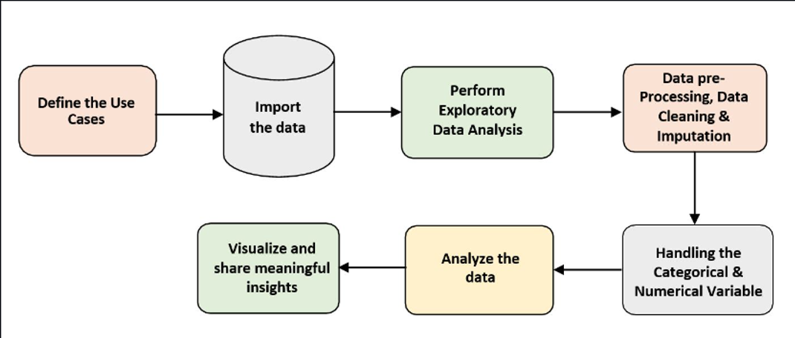
ARCHITECTURE

Slide 8
Our project will be a full functioning aggregation of recommender systems algorithms like collaborative filtering , content based filtering along with sentiment analysis.
We have split the project into 4 distinct modules
ALGORITHMS PROPOSED

Slide 9
Data Cleaning
Acquiring the raw data from the source and visualizing the attributes and rows to understand the data
Grouping data based on pin code and other influential attributes
Finding missing values and solving the issue by data imputation ( mean/median/mode)
Separating property listings into text and numerical for data modelling
Data normalization
Exporting the cleaned data to csv

Slide 10
Natural Language Processing
Performing the necessary text pre-processing steps for each reviewer's comments (including language detection)
Using NLTK's Vader lexicon to calculate the compound polarity and subjectivity of text columns
Performed Sentiment Analysis on Text fields
Found Average polarity and subjectivity of all text columns

Slide 11
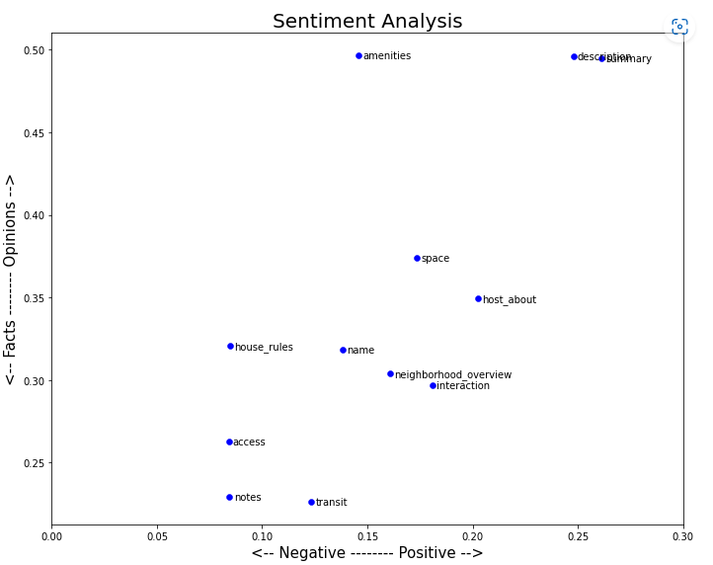
Results
Airbnb listings tend to be positive when it comes to descriptions and summaries.
This makes sense, hosts want to encourage people to stay at their Airbnb and having a positive description is beneficial.
However, these descriptions tend to be grounded in opinion
Interesting to note that amenities are considered very opinionated
One would expect that amenities would be more grounded in facts.

Slide 12
Clustering
Preprocessing of categorical and ordinal features. Converted to numerical features
Established order for ordinal features
Performed Scaling of features to ensure all the features are normalized.
Converted the feature matrix to embeddings for visualization of clusters.
Found optimal number of clusters using silohouette score and inertia. Assigned cluster labels to all Airbnb listings using KMeans Clustering.

Slide 13
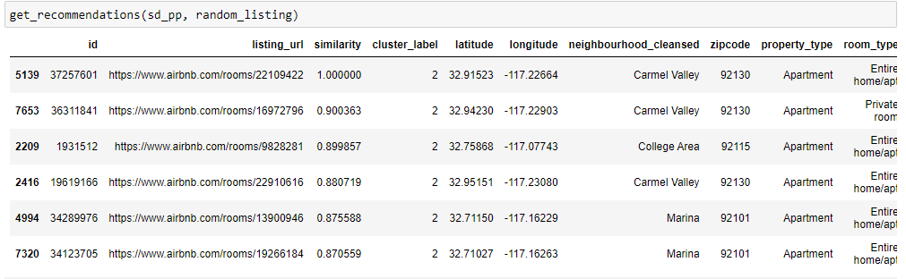
Recommendation engine – Collaborative filtering and Sentiment Analysis
Created a custom function which takes two arguments, the dataframe and a Airbnb listing.
Found cosine similarity to recommend Top 6 most similar Airbnb listings

Slide 14
Results -
• From the cluster plot , we can see that the dataset has different clusters
• We performed clustering to find the cluster labels for each and every review
• We then used the cluster labels and the calculated features to recommend similar Airbnb listing using Cosine Similarity

